Slide 1


BloomQuest
A Personalized Learning Platform based on Bloom’s Taxonomy and Knowledge based concepts.
Project ID : 2023-035

Slide 2
BACKGROUND
University students face academic pressure and stress.
Struggles with subjects, assignments, and exams.
Lack of efficient study strategies.
Unaware of Bloom's Taxonomy impact on exams.
MAIN OBJECTIVE
Provide a platform for university students to do self-studies efficiently and effectively.
Project ID : 2023-035

Slide 3
WHAT IS BloomQuest?
Personalized self-learning system incorporating Bloom's Taxonomy.
Empowering students to identify cognitive levels and develop skills.
Key Features:
Performance tracking and insights for each module.
Mind map generation based on student-uploaded study materials as the foundation.
Advanced search functionality for extended learning.
Quizzes based on Bloom's Taxonomy.
Project ID : 2023-035

Slide 4
OVERALL SYSTEM

Slide 5
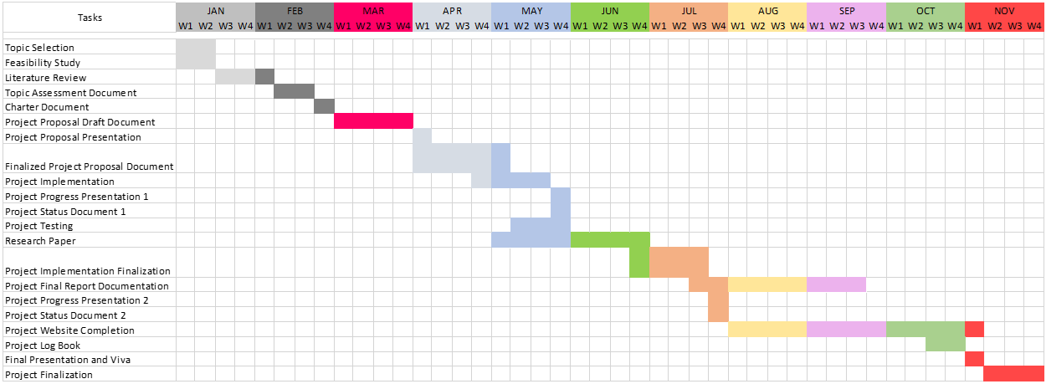
GANTT CHART
Project ID : 2023-035

Slide 6

TRACK AND PREDICT STUDENT PERFORMANCE.
IT20123468 | SENAWEERA T.I.S
Software Engineering
IT20123468 | Senaweera T.I.S. | 2023-035

Slide 7


RESEACRH PROBLEM
“How can university students assess their academic performance level while doing self-studies?”
SOLUTION
“Develop a method to predict student performance utilizing Bloom's Taxonomy levels integrated with Exponentially Weighted Moving Average (EWMA).”
IT20123468 | Senaweera T.I.S. | 2023-035

Slide 8
RESEARCH GAP
Limited researches on exploration of using Bloom's Taxonomy as a predictive tool and its combination with machine learning techniques.
Novelty:
Versatile framework that can be applied to any subject in educational field.
Focus on potential of combining
Bloom's Taxonomy and
Exponentially Weighted Moving Average (EWMA)
with machine learning models to gain a more comprehensive understanding of student abilities.
Measure progress over time by giving more importance to the most recently data.
IT20123468 | Senaweera T.I.S. | 2023-035

Slide 9
COMPONENT DIAGRAM
IT20123468 | Senaweera T.I.S. | 2023-035

Slide 10
DATA COLLECTION METHODOLOGY
Assessment Design
Database Technologies (13 weeks/ 4 credits)
4 Quizzes
Mapped to Bloom’s Taxonomy Levels:
L1: Remember and Understand
L2: Apply
L3: Analyze, Create, and Evaluate
Data Collection
140 students
Data Preparation
Data Pre-processing and Finalization
Data Analysis
Model Training
Dataset 1 – Overall Marks Only.
Dataset 2 – EWMA of Bloom’s Level Marks.
Pass/Fail Categorization
(SMOTE – Class balancing)
Pearson correlation coefficient analysis
Classification Model: Predict Pass/Fail status.
Regression model: Predict final exam mark.
IT20123468 | Senaweera T.I.S. | 2023-035

Slide 11
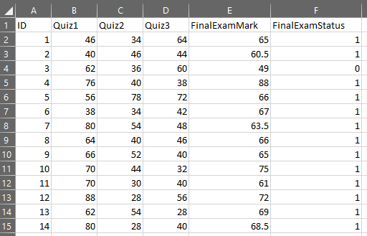
DATASETS OVERVIEW
2 Methodologies followed to generate 2 datasets.
Dataset 1: Final Marks Only.
Considered only the overall mark of each quiz.
E.g.: Methodology followed by SLIIT examiners to create final exam paper.
IT20123468 | Senaweera T.I.S. | 2023-035

Slide 12
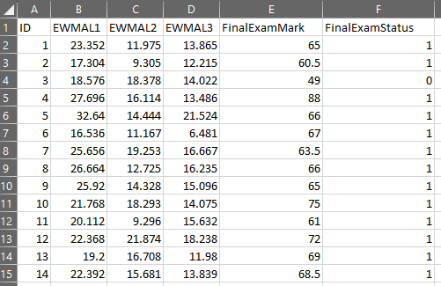
DATASETS OVERVIEW
Dataset 2: EWMA of Bloom’s Level Marks.
Considered bloom’s level wise marks of each quiz.
Calculated an average using Exponentially Weighted Moving Average (EWMA) for each level.
IT20123468 | Senaweera T.I.S. | 2023-035

Slide 13
MODELS USED
Regression Models:
Classification Models:
Linear Regression.
Ridge Regression.
Lasso Regression.
SVR – Linear.
SVR – RBF
Decision Tree.
Random Forest.
Gradient Boosting.
Multi-Layered Perceptron (MLP)
Logistic Regression.
Decision Tree.
Random Forest.
SVM
K-Nearest Neighbors (KNN)
Multi-Layered Perceptron (MLP)
IT20123468 | Senaweera T.I.S. | 2023-035

Slide 14
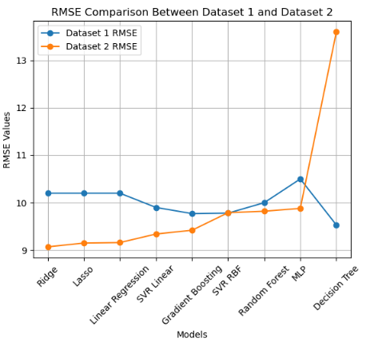
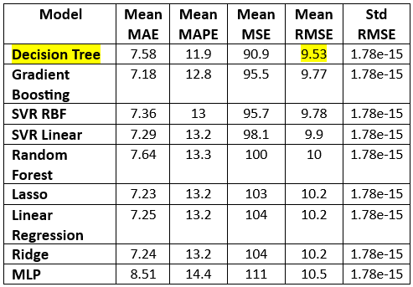
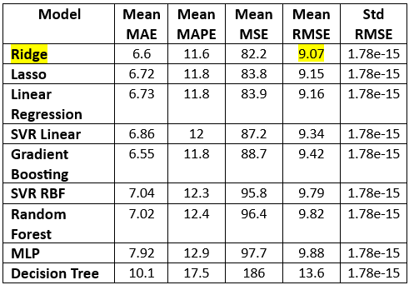
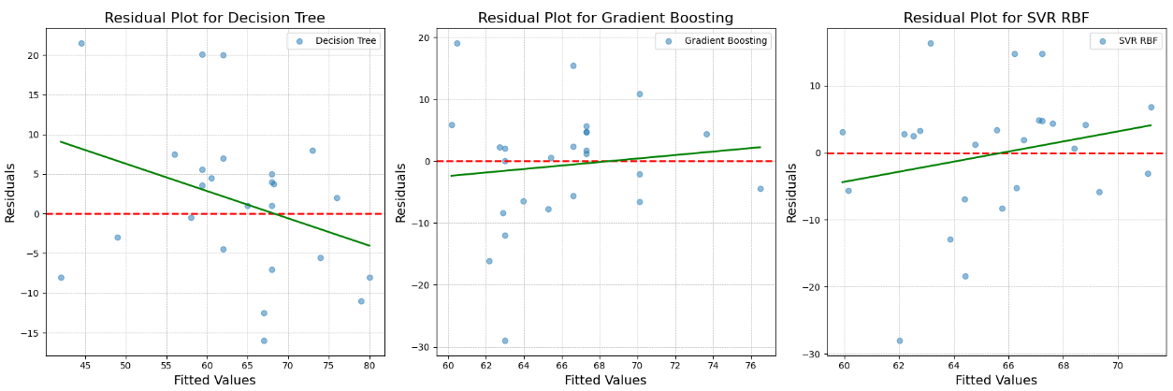
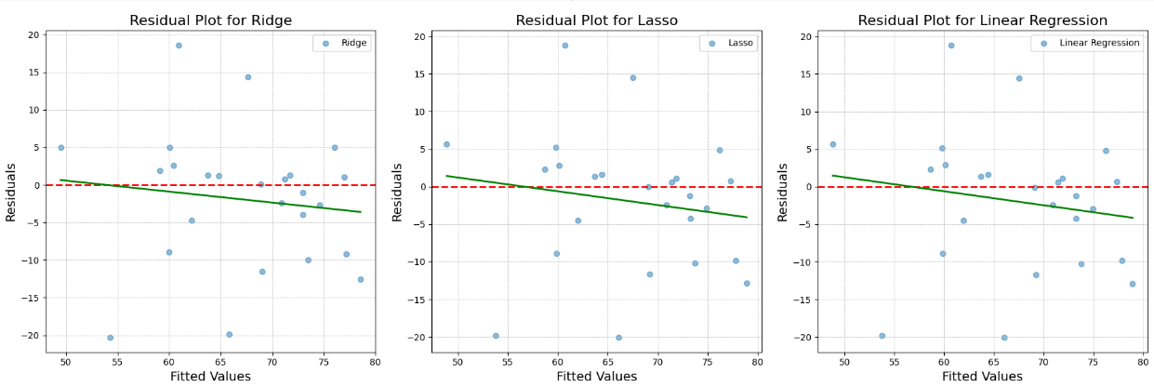
TESTING AND RESULTS – Experiment 1: Regression Models
Dataset 1: Final Marks Only.
Dataset 2: EWMA of Bloom’s Level Marks.
IT20123468 | Senaweera T.I.S. | 2023-035

Slide 15
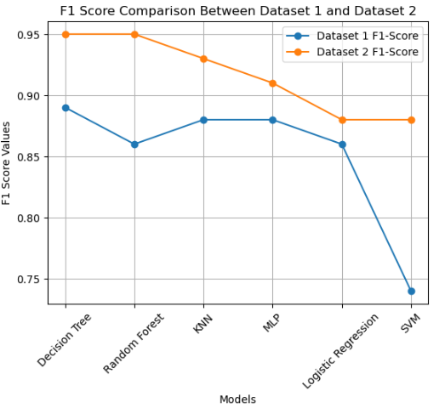
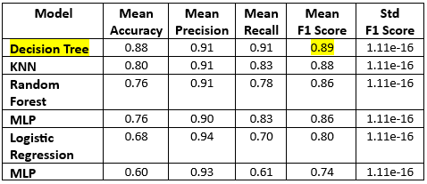
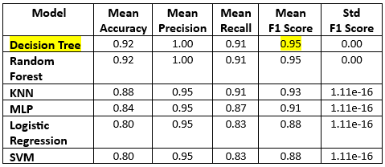
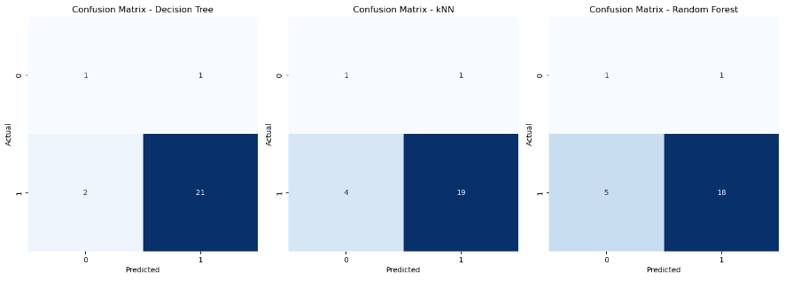
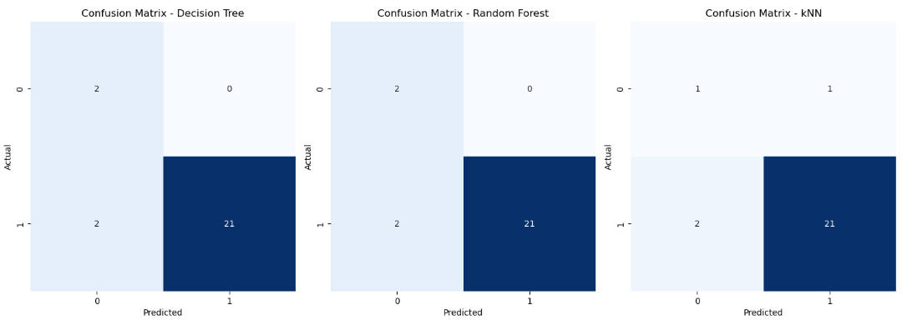
TESTING AND RESULTS – Experiment 2: Classification Models
Dataset 1: Final Marks Only.
Dataset 2: EWMA of Bloom’s Level Marks.
IT20123468 | Senaweera T.I.S. | 2023-035

Slide 16
KEY FINDINGS
Experiment 1: In regression tasks, methodology 2, enriched with taxonomy levels, slightly outperformed other models by producing lower errors.
Experiment 2: Both datasets performed well in classification, with methodology 2 showing a slight advantage in accuracy and balanced precision and recall.
Experiments confirm our method (combination of Bloom’s Taxonomy and EWMA) is slightly better than the normal method.
IT20123468 | Senaweera T.I.S. | 2023-035

Slide 17
TOOLS AND TECHNOLOGIES
Python, sklearn library.
React js, React Charts and Recharts libraries.
Machine Learning
Anaconda
Windows 10
Git Version Control
IT20123468 | Senaweera T.I.S. | 2023-035

Slide 18
NON-FUNCTIONAL REQUIREMENTS
User-friendly and visually appealing interface.
Modularity of components for easy maintenance.
Availability, ensuring students can access it when needed.
Ensure only authenticated users can access their data, and they have the right permissions.
IT20123468 | Senaweera T.I.S. | 2023-035

Slide 19
REFERENCES
G. N. R. Prasad, “Evaluating student performance based on bloom’s taxonomy levels,” in Journal of Physics: Conference Series, IOP Publishing Ltd, Mar. 2021. doi: 10.1088/1742-6596/1797/1/012063.
H. Darman, S. Musa, R. Ramasamy, and R. Rajeswari, “Predicting Students’ Final Grade in Mathematics Module using Multiple Linear Regression,” 2019.
M. A. Ma’sum, “Predicting Student Achievement before Final Exam: A Regression-Based Approach,” in 2022 2nd International Conference on Information Technology and Education, 2022.
“Exponentially Weighted Moving Average (EWMA),” Corporate Finance Institute, CFI Team. Accessed: Aug. 2023. [Online]. Available: https://corporatefinanceinstitute.com/resources/capital-markets/exponentially-weighted-moving-average-ewma/
IT20123468 | Senaweera T.I.S. | 2023-035

Slide 20

GENERATES A COMPREHENSIVE
MIND-MAP FOR A GIVEN MATERIAL USING KNOWLEDGE BASED CONCEPTS.
Data Science
IT20133504 | Weerasekara n. n.
IT20133504 | Weerasekara N.N. | 2023-035

Slide 21


Research Problem
Proposed Solution
This research attempts to design a knowledge-based system that uses domain-specific knowledge to generate more precise and significant mind maps from text input to get over this constraint.
"Can a Knowledge base system improve the usefulness of Mind-maps generated from text data compared to existing text mining algorithms and ML approaches?"

Slide 22
RESEARCH GAP
Existing tools mainly use text mining algorithms and ML approaches and only focused on creating mind maps for short text which takes considerable amount of time to generate the mind-map.
Novelty : New approach uses Knowledge-based concepts and extends the capability to handle longer text, offering a more comprehensive and versatile approach with a reasonable time.
IT20133504 | Weerasekara N.N. | 2023-035

Slide 23
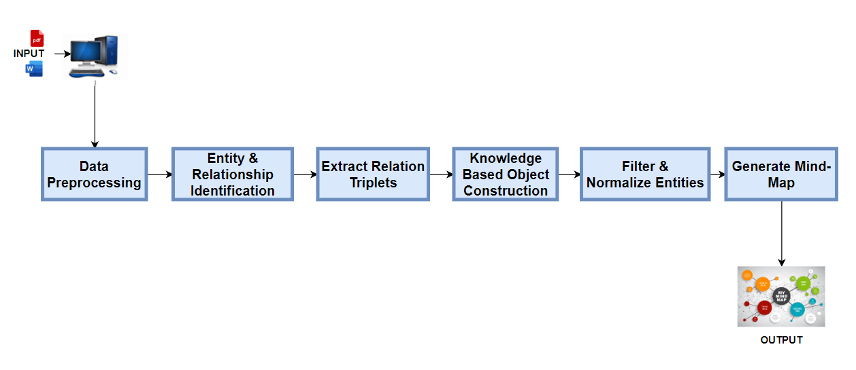
COMPONENT DIAGRAM
IT20133504 | Weerasekara N.N. | 2023-035

Slide 24
EXPERIMENTS & RESULTS
The main goal of this created test plan is to carefully assess and certify the quality and authenticity of the mind map produced by the given approach.
IT20133504 | Weerasekara N.N. | 2023-035

Slide 25
EXPERIMENTS
Experiment 1: Input a simple paragraph with a single concept and verify that the generated mind map accurately reflects the concept.
Preparation: Choose a straightforward paragraph with a single, distinct topic.
Example : Cloud computing deployments.
IT20133504 | Weerasekara N.N. | 2023-035

Slide 26
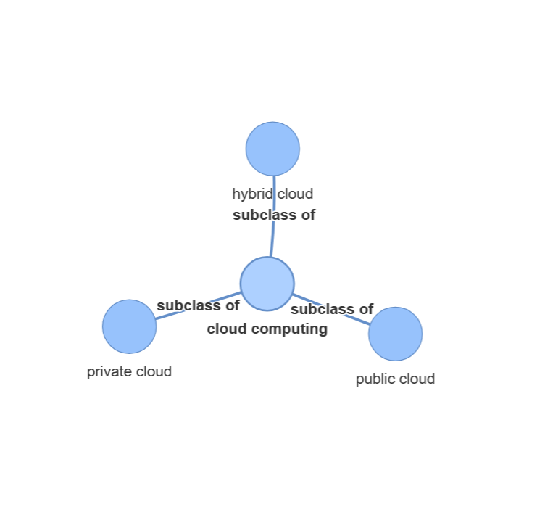
Results
Input paragraph
Output
Output
In the realm of cloud computing, there exist three primary deployment models: public cloud, private cloud, and hybrid cloud, each delineating distinct approaches to storing, managing, and accessing data and applications through remote servers over the internet, offering varying degrees of control, security, and scalability to cater to diverse user needs and preferences.
IT20133504 | Weerasekara N.N. | 2023-035

Slide 27
EXPERIMENTS
Validation Steps: - Check the mind map that was developed and make sure the core node is " Cloud computing " . - Make sure the mind map doesn't contain any more unconnected connections or thoughts.
Verification: The generated mind map precisely and completely captures the single notion from the paragraph.
IT20133504 | Weerasekara N.N. | 2023-035

Slide 28
EXPERIMENTS
Experiment 2 : Input a document with multiple concepts and verify that the generated mind map accurately reflects all the concepts.
Preparation: Create a complicated text with several levels of supporting ideas, such as “Cloud Computing operations and examples"
IT20133504 | Weerasekara N.N. | 2023-035

Slide 29
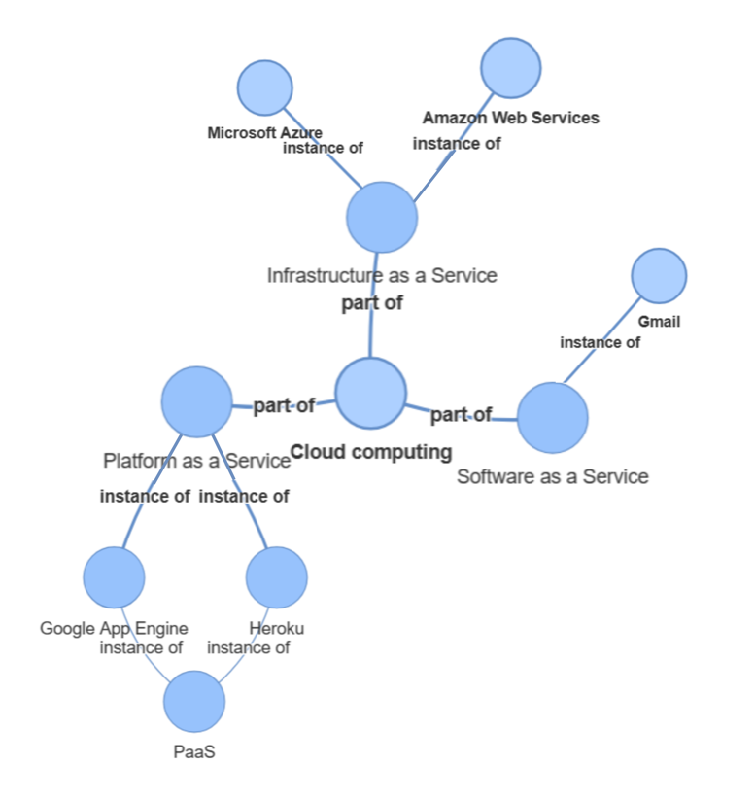
Results
Input paragraph
Output
Cloud computing revolutionizes how we store and manage data, operating through three primary components: Infrastructure as a Service (IaaS), Platform as a Service (PaaS), and Software as a Service (SaaS). IaaS, akin to leasing computers and storage via the internet, is exemplified by industry leaders such as Amazon Web Services and Microsoft Azure. These services provide access to computing resources and storage on-demand. PaaS is tailored for software developers, offering them the requisite tools and platforms to design, test, and deploy applications. Notable examples of PaaS include Google App Engine and Heroku, streamlining the app development process. SaaS, on the other hand, delivers accessible online software like Gmail and Microsoft Office 365, offering ready-to-use applications directly via the internet. These three segments function distinctly, catering to varied user needs and organizational requirements, fostering a new era of flexible and scalable computing solutions.
IT20133504 | Weerasekara N.N. | 2023-035

Slide 30
EXPERIMENTS
Validation Steps:
- Make sure the created mind map properly captures all the sub-concepts and establishes a hierarchical structure by carefully going through it.
- Verify that the mind map accurately depicts the connections between the primary concepts and their supporting notions.
Verification: The created mind map properly captures all the sub-concepts and establishes a hierarchical structure by carefully going through it.
IT20133504 | Weerasekara N.N. | 2023-035

Slide 31
EXPERIMENTS
Experiment 3 : Input a document with a large text and verify that the generated mind map does include the information
IT20133504 | Weerasekara N.N. | 2023-035

Slide 32
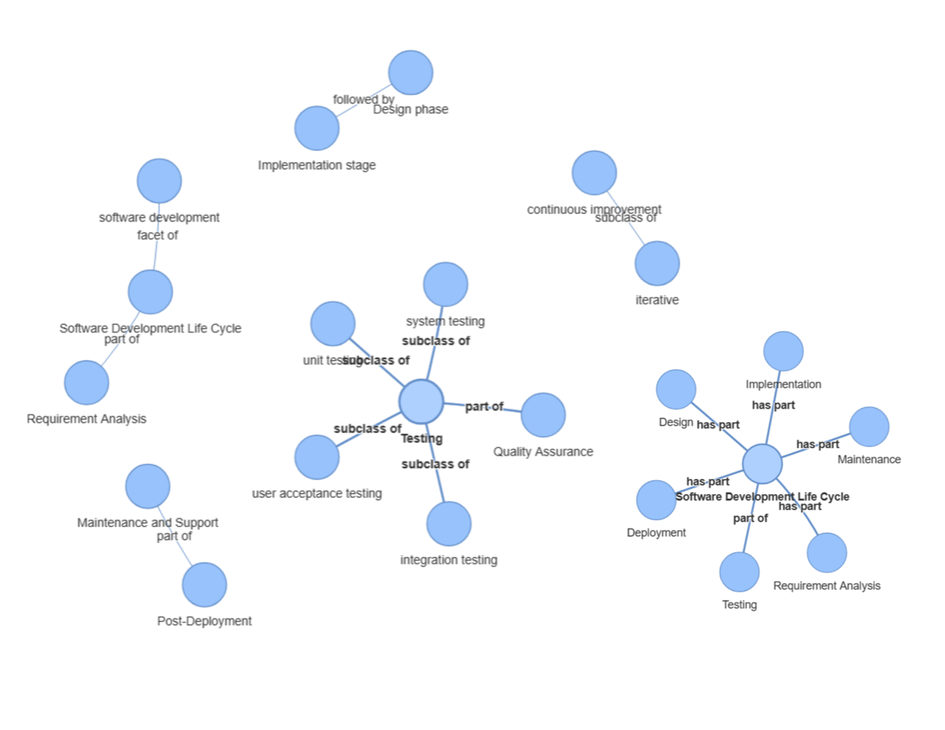
Results
Output
Input pdf that contains about Software Development Life Cycle.
IT20133504 | Weerasekara N.N. | 2023-035

Slide 33
KEY FINDINGS
One key finding would be the completeness of the mind map. It involves assessing whether the mind map encapsulates all relevant subtopics and details associated with the concept provided in the input paragraph.
The crucial aspect lies in evaluating the quality of the visual representation, assessing the clarity of relationships, information organization, and the ease of comprehending the hierarchy within the mind map for enhanced accessibility and understanding of the concept.
Another key finding would be assessing the accuracy of the mind map in reflecting the central concept from the input paragraph. If the system accurately captures and represents the key points, relationships, and subtopics of the concept in the mind map.
IT20123468 | Senaweera T.I.S. | 2023-035

Slide 34
NON-FUNCTIONAL REQUIREMENTS
Performance: The system process text and generate mind maps in a reasonable time frame. Splitting into Spans: When you have a long text, it can be challenging for the program to work with the whole thing at once. So, I implemented a function, you break the long text into smaller parts called "spans." Each span covers a chunk of the long text, and these spans overlap a little bit to make sure no information is missed.
Accuracy: Entity recognition and relation classification more accurate, it ensure the quality of the mind map.
Scalability: The system handle both small and large pdf study materials.
IT20133504 | Weerasekara N.N. | 2023-035

Slide 35

RESOURCES RECOMMENDATION SYSTEM
IT20133368 | Wijayasena w.d.n.d.t
Data Science
IT20133368 | Wijayasena W.D.N.D.T. | 2023-035

Slide 36


RESEACRH PROBLEM
How can university students find more relevant extra study resources that suite to their level and their preferences while doing self-studies?
PROPOSED SOLUTION
Develop an effective recommendation component that provides personalized and contextually relevant resources during their self-study sessions.
IT20133368 | Wijayasena W.D.N.D.T. | 2023-035

Slide 37
RESEARCH GAP
More researches on term-based approaches which doesn’t identify the underling meaning of the student’s input query.
Less recommendation systems that mainly focusing university students preferability.
Novelty:
New method combining a topic-based approach to identify the underlined meaning of lengthy paragraphs.
Innovative approach to recommend both textual documents and educational videos that tailored to academic interests to university student by considering their preferability.
IT20133368 | Wijayasena W.D.N.D.T. | 2023-035

Slide 38
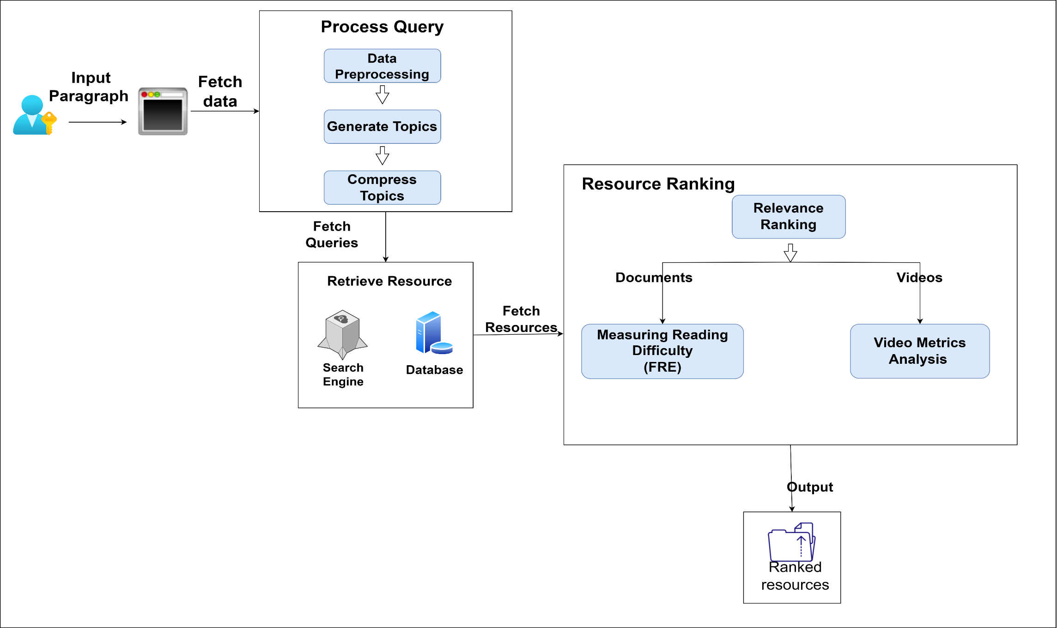
COMPONENT DIAGRAM
IT20133368 | Wijayasena W.D.N.D.T. | 2023-035

Slide 39
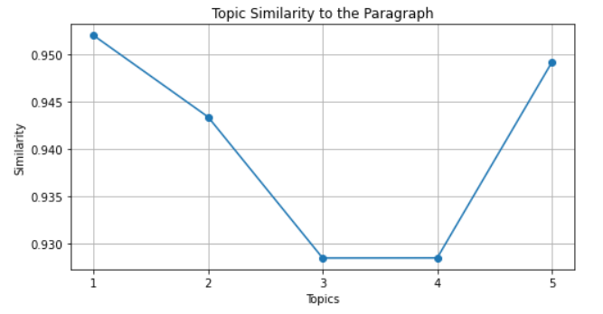
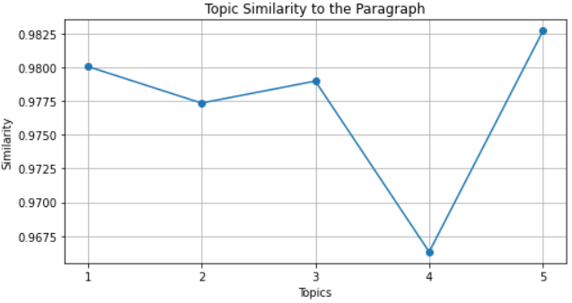
Accuracy of the Generated Topics
Algorithms and data structures are central to computer science. The theory of computation concerns abstract models of computation and general classes of problems that can be solved using them. The fields of cryptography and computer security involve studying the means for secure communication and for preventing security vulnerabilities.
1. computation security computer
2. computation security vulnerability
3. preventing problem communication science
4. science theory solved structure
5. preventing structure involve field
DBMS optimizes the organization of data by following a database schema design technique called normalization, which splits a large table into smaller tables when any of its attributes have redundancy in values. DBMS offer many benefits over traditional file systems, including flexibility and a more complex backup system.
table system DBMS
DBMS Table
DBMS system Table
offer complex redundancy backup
value attribute design data

Slide 40
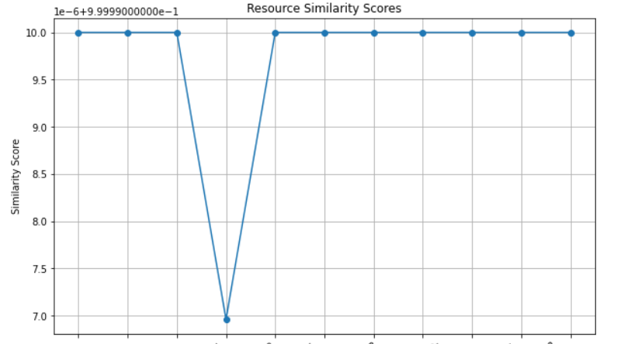
Accuracy of the Retrieved Resources
Input Paragraph
Algorithms and data structures are central to computer science. The theory of computation concerns abstract models of computation and general classes of problems that can be solved using them. The fields of cryptography and computer security involve studying the means for secure communication and for preventing security vulnerabilities.
Generated Paragraph
Cyber Security Full Course 2023 | Cyber Security Course Training For Beginners 2023
Computational irreducibility and computer security
Common Types Of Network Security Vulnerabilities In 2023
Cloud Security Vulnerabilities, Management, and Communication
Cyber Security In 7 Minutes | What Is Cyber Security

Slide 41
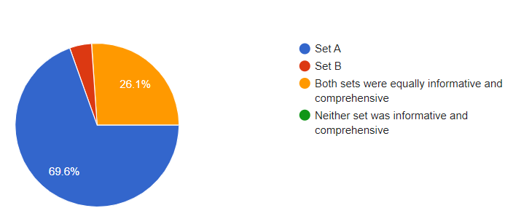
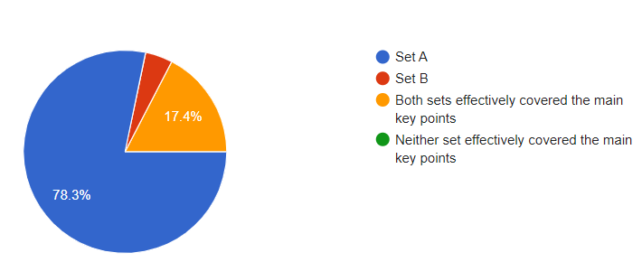
User Satisfaction
Check the user satisfaction of the retrieved resources by comparing with other resources that retrieved using another recommender systems.
60.9% students mentioned that resources that retrieved by this system met their expectation
78.3% students mentioned that resources that retrieved by this system, effectively covers the main key points of the whole input query?

Slide 42

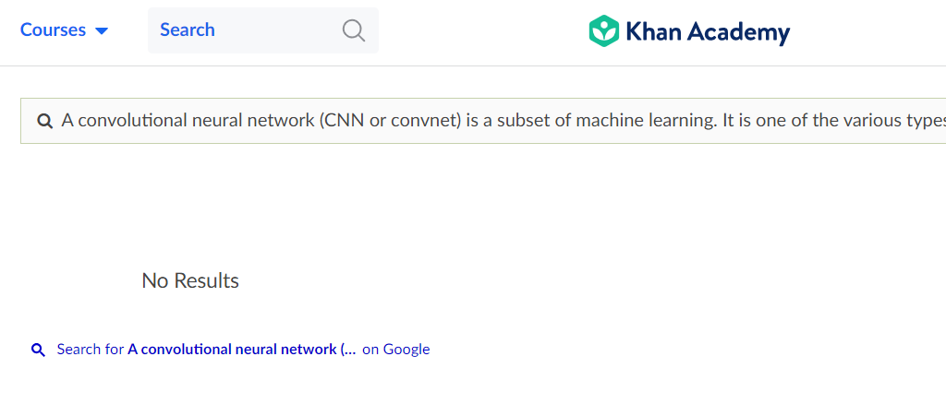
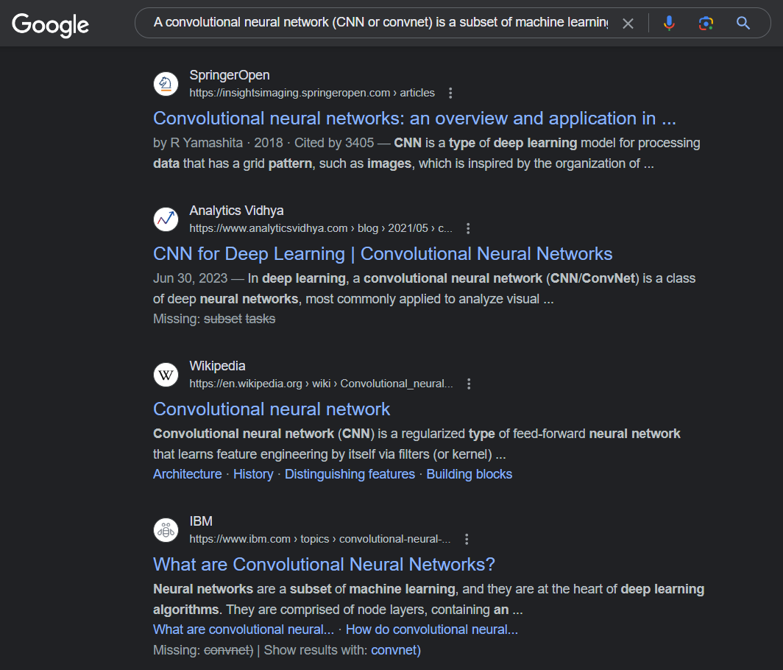
What are other resource recommendation systems results for lengthy paragraphs
Khan Academy doesn’t give results for
lengthy query
Chegg give more unrelated results
Google sometimes consider only single topic from that long paragraph

Slide 43
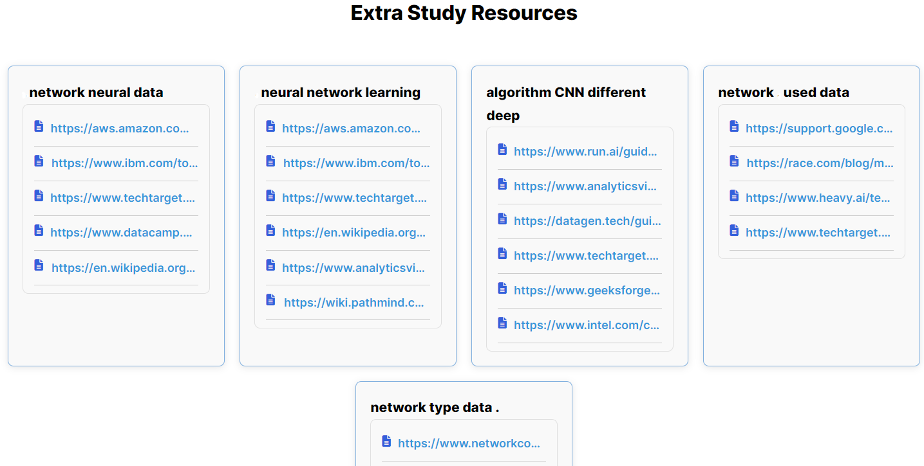
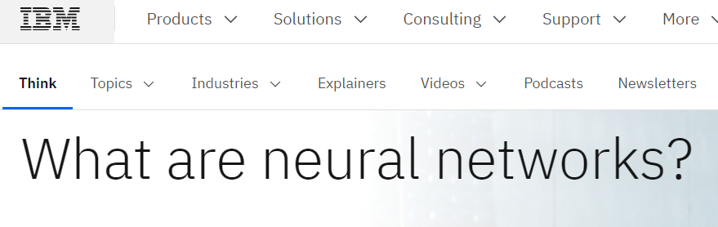
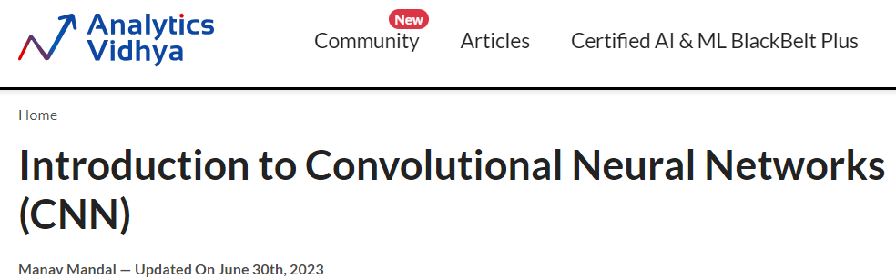
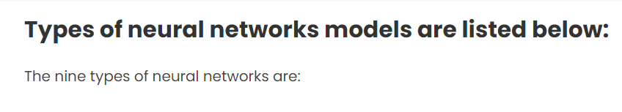
How this system give results for lengthy paragraphs
A convolutional neural network is a subset of machine learning. It is one of the various types of artificial neural networks which are used for different applications and data types. A CNN is a kind of network architecture for deep learning algorithms and is specifically used for image recognition and tasks that involve the processing of pixel data.

Slide 44
NON-FUNCTIONAL REQUIREMENTS
Response Time: The system need to provide recommendations within a reasonable time frame, typically within a few seconds.
Accuracy:
Topic Modeling Accuracy: The topic modeling and content analysis should be precise in identifying relevant educational topics.
Recommendation Accuracy: The system should provide highly relevant and accurate resource recommendations to users.
Availability, ensuring students can access it when needed.
IT20133368 | Wijayasena W.D.N.D.T. | 2023-035

Slide 45

QUIZZES GENERATING COMPONENT.
IT20126438 | Colambage K.g
Data Science
IT20126438 | Colambage K.G | 22023-035

Slide 46


Background
What is Generate a set of questions and answers using knowledge graph and categorize them according to bloom’s taxonomy?
Generating a set of questions and answers using a knowledge graph involves extracting information from a structured representation of knowledge and transforming it into a set of questions and answers. Bloom's taxonomy is a framework for categorizing educational goals and objectives into levels of cognitive complexity. Categorizing the questions and answers generated by the knowledge graph according to Bloom's taxonomy involves mapping them to the appropriate level of cognitive complexity, such as remembering, understanding, applying, analyzing, evaluating, or creating. This can help ensure that the questions and answers are appropriate for the level of learning intended and can guide the design of instructional materials and assessments
• What is reason for selecting this system
I have done a survey by getting details from the academic staff the SLIIT campus , that the students those who are in the campus are not aware and not have enough knowledge about this system.
IT20126438 | Colambage K.G | TMP-23-035

Slide 47
Research Problem
"How can generating questions and answers and categorizing them according to Bloom's taxonomy is the limited availability of question generation techniques specifically designed to align with the taxonomy .?"
IT20126438 | Colambage K.G | 22023-035

Slide 48

PROPOSED SOLUTION
Develop a question generation framework that explicitly incorporates the cognitive complexity levels defined by Bloom's taxonomy. The framework can utilize natural language processing techniques, machine learning algorithms, and educational domain knowledge to automatically generate questions that align with the desired taxonomy level.
IT20126438 | Colambage K.G | 22023-035

Slide 49
RESEARCH GAP
Previous Studies
This Study
That generates, multiple-choice questions based on lecture notes. Use NLG
Generate True or false Questions and multiple-choice Questions based on Paragraph. Use NLP
VS
Generating self-study questions with a knowledge graph and Bloom's Taxonomy to generating quiz questions.
Exam Based Self learning system Generate Questions & Answers Categorize Bloom's Taxonomy level.
IT20126438 | Colambage K.G | 22023-035

Slide 50
RESEARCH GAP
Previous Studies
This Study
Question contain mostly keyword associated Analyzing , Understanding, Remembering level then can categories in to 3 levels..
contain mostly keyword associated Analyzing level
VS
focused on either question generation or Bloom's categorization,
Simultaneously Generate Both Questions generation and Categorization.
IT20126438 | Colambage K.G | 22023-035

Slide 51
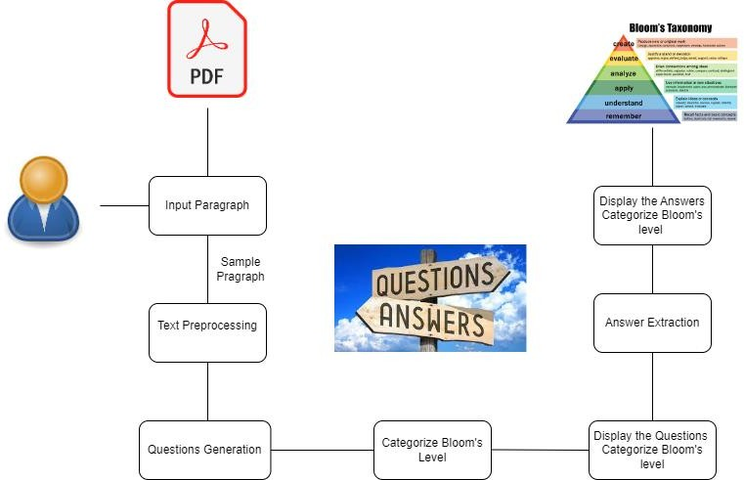
COMPONENT DIAGRAM
IT20126438 | Colambage K.G | 22023-035

Slide 52
Experimental Results
Our experiments involved utilizing educational texts and paragraphs from various domains. The system was tested on a diverse set of topics to ensure its applicability across different subjects. The results demonstrated the effectiveness of our approach in generating meaningful questions and answers.
Bloom's Taxonomy Categorization Accuracy: Our system achieved an accuracy of approximately 85% in categorizing generated questions into the correct Bloom's taxonomy levels.
Generate Questions Relevance: The generated questions received a high meaningfulness score from educators, indicating that they align well with the expected cognitive skills associated with Bloom's taxonomy levels.
Answer Relevance: The extracted answers were highly relevant to the generated questions, with an average relevance score of 4.5 out of 5.

Slide 53
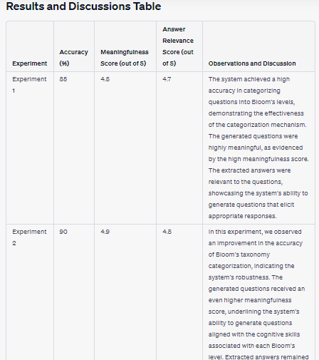

Slide 54
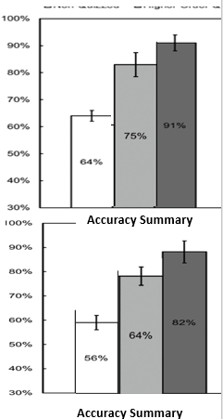
Accuracy in Question & Answering System
This System Accuracy Summary
Accuracy Level: The accuracy of this system would depend on the quality of its training data and the effectiveness of the categorization into Bloom's taxonomy levels. If your system is well-designed and trained on high-quality educational data, it should perform well in categorizing questions and generating answers.
Percentage: this can calculate accuracy as a percentage by measuring how many questions were correctly categorized into the appropriate Bloom's taxonomy level and how many answers were accurate. For example, if 91% of this questions are accurately categorized and 75% of the answers are correct, this system has an 64% accuracy rate for question categorization and a 91% accuracy rate for answers.
Another System Accuracy Summary
Accuracy Level: The accuracy of a typical question-answering system, such as one based on large pre-trained models like GPT-3, would depend on its training data, model size, and the quality of the sources it has access to. These models are often highly accurate and can provide answers with high precision.
Percentage: Similar to your system, For example, if 82% of this questions are accurately categorized and 64% of the answers are correct, this system has an 64% accuracy rate for question categorization and a 56% accuracy rate for answers

Slide 55
NON-FUNCTIONAL REQUIREMENTS
​
Performance: Your component should be able to generate questions and answers quickly and efficiently, even with large amounts of data.​
Scalability: The component should be designed to handle increasing amounts of data and user traffic over time.​
Usability: The user interface should be intuitive and easy to use for both technical and non-technical users.​
Security: The component should be designed to prevent unauthorized access and protect sensitive data.​
IT20126438 | Colambage K.G | 22023-035

Slide 56
COMMERCIALIZATION
BloomQuest Lite (Free Version)
BloomQuest Premium (100$ Annually)
Basic quizzes focused primarily on the lower levels (Remember & Understand) of Bloom's Taxonomy will be generated.
Suggest extra resources up to only 3 times per day.
Show a basic or partial mind map, providing a glimpse.
Display non-intrusive advertisements.
Quizzes will be generated to cater all levels of Bloom's Taxonomy.
Performance prediction based on historical data.
A detailed dashboard visualizing student's performance across various levels of Bloom's Taxonomy.
Unlimited suggestions of extra resources.
Full access to mind maps with downloading feature.
Ad-Free Experience.
Project ID : 2023-035

Slide 57
BUSINESS PLAN
Target Audience
University Students.
Homeschooling Parents.
Educational Institutions.
Adult Learners & Lifelong Learners
Marketing Plan
Social Media Marketing Campaigns.
Awareness Session for Students.
Email Marketing for Educational Institutions.
Project ID : 2023-035

Slide 58
Thank you.
Project ID : 2023-035

